Slide 2
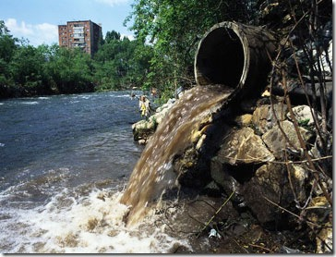
A LARGE PERCENT OF SEWAGE REMAINS UNTREATED

Slide 3
RECYCLING WATER : NEED OF THE TIME
2.5% OF THE EARTH’S WATER IS ONLY FRESH WATER
70% OF THAT IS FROZEN
U.N WARNS OF WATER SCARCITY BY 2030
ZERO HOUR : CAPE TOWN, NOW BANGALORE

Slide 4
SEWAGE TREATMENT
WITH
BIO-FILTER

Slide 5
SEWAGE TREATMENT
The Process pioneered by Absolute Water is totally different from the conventional processes in existence at present.
It is a totally Green process that does not use any Aeration (power), or Chemicals, and most importantly, produces NO Sludge.
The process is based on a mix of Vermi-cast and Micro-Organisms that naturally degrade all the pollutants in the raw sewage, converting some into nutrients.

Slide 6
STP BIOFILTER
The BIOFILTER works on the principal of vermi-filtration where specially bred worm species and a mix of bacteria act on the suspended and dissolved solids in the raw sewage and biologically degrade in an environmentally safe manner.
This is a continuous process, therefore the treated sewage keeps flowing through an inclined drain at the floor of the bio-filter into the treated sewage tank which can be used for further treatment or irrigation / horticulture etc.

Slide 7
USP
It solves two of the biggest issues of conventional STP
Sludge management : Due to no sludge formation it eliminates the problem of sludge dewatering , handling and disposal
Power requirement: has a very low requirement and can also be catered via solar panels

Slide 8
BIOFILTER ADVANTAGES
Power : 1.0 kW/ 100 KLD
just for running the pumps
Green process
therefore no use of chemical
Extremely low operating costs
Organic media replacement is humus, a bio compost ( 6-8 monthly)
NO Tanks/ Aeration/ Sludge separation, therefore very low civil cost
No Noise ( since no aeration device involved)

Slide 10
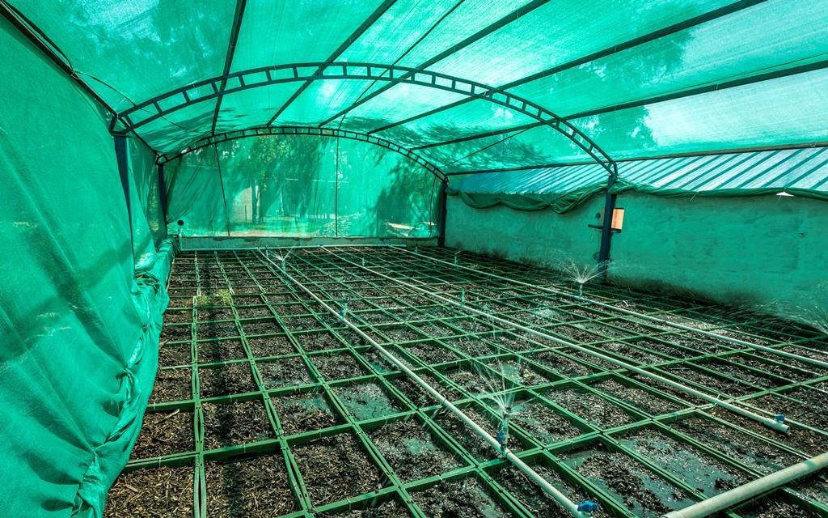
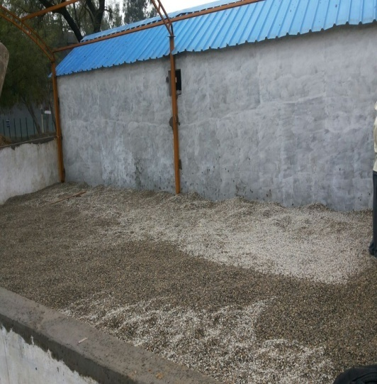
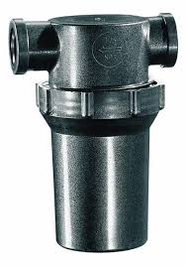
BIO-FILTER FOR CIVIL BASED SEWAGE TREATMENT PLANT DETAILS
Truss work and media laying
Bio-Filter Basin Internal view
Inorganic Media layers Loading
Pre- Filter Strainer

Slide 11
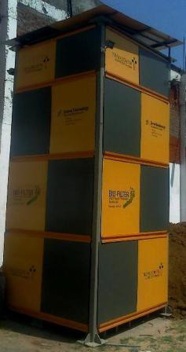
PLANT SIZE
Modular systems have been designed for smaller requirements, e.g. 20 -50 KLD.
These would cater for communities like villages, housing colonies, localized treatment plants, etc.
Assuming 30 litres/day/person as the sewage output, a 30 KLD modular plant would suffice for a community of 1000 persons.
SOLAR: Because of the extremely small power requirement, this modular plant is ideally suited to use Solar power to run a small pump.
This makes it independent of power supply, thus ensuring its usefulness throughout the day.
The footprint of the 30 KLD modular plant is 3 x 3 meters.
For larger requirements, 1-5 MLD plants can be designed. The area required is roughly 0.8 m2/KLD.
*KLD: Kilo Liters a day

Slide 12
WATER RECOVERY
This is non-R.O. System with a very high recovery (> 80 %).
The specially designed Membrane not only filters out various contaminants but also the harmful Bacteria, Viruses, and other Pathogens.
The feed is taken from the treated sewage tank and is passed through a pressure sand filter to remove the suspended solids, if any. There is another filter to ensure that the feed to the membranes does not have any particles in it. This ensures long life for the membranes.
The Permeate from the membrane is of Potable/Contact water/Bathing water quality .

Slide 13
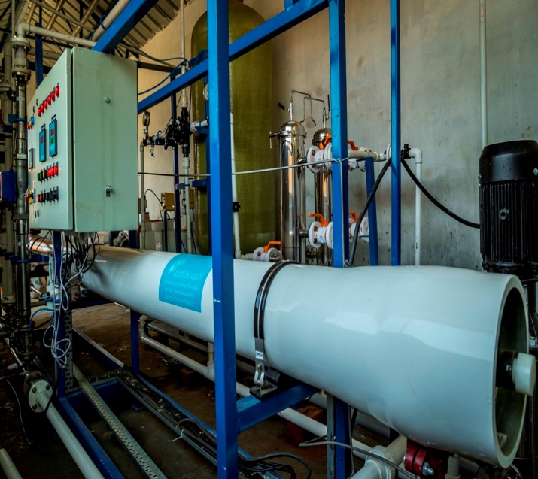
MEMBRANE FILTRATION
Non R.O. ( Low power)
Recovery : > 80 %
Removes BACTERIA, VIRUSES, PATHOGENS
Potable water quality
Reject high in nutrients
REJECT PARAMETERS
BOD: < 10mg/l
DO: 2-4mg/l

Slide 14
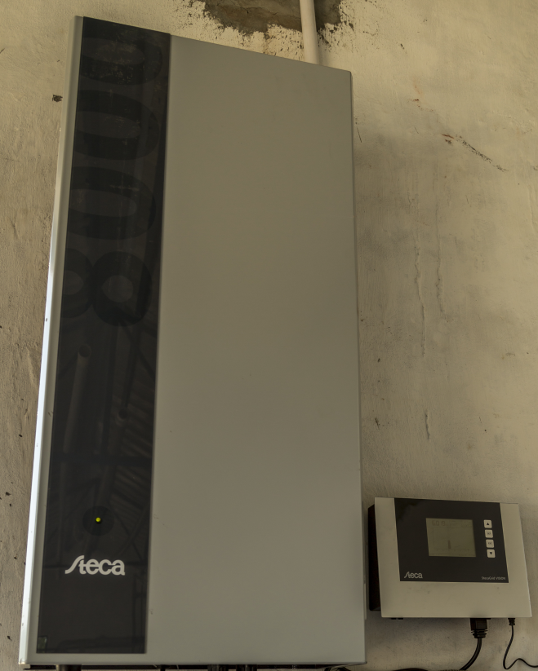
SOLAR POWER ( OPTIONAL) FOR MEMBRANE SYSTEM:
Can work 24 X 7
Power supply not a constraint
Environment friendly
Will require Roof Area

Slide 15
TREATABLE CAPACITY
3KLD upto 50 KLD: Modular Plants
50KLD-3MLD: Civil based
To treat upto Agricultural Quality : Ozonation required but no membrane is used .
To treat upto drinking quality : use of specialized membrane
*KLD: Kilo Litres a day

Slide 16
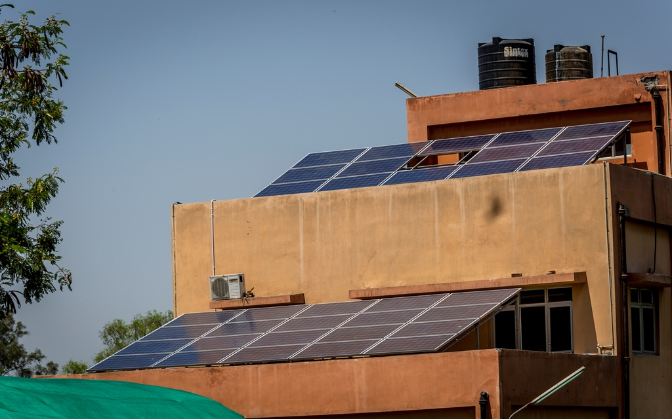

Slide 17
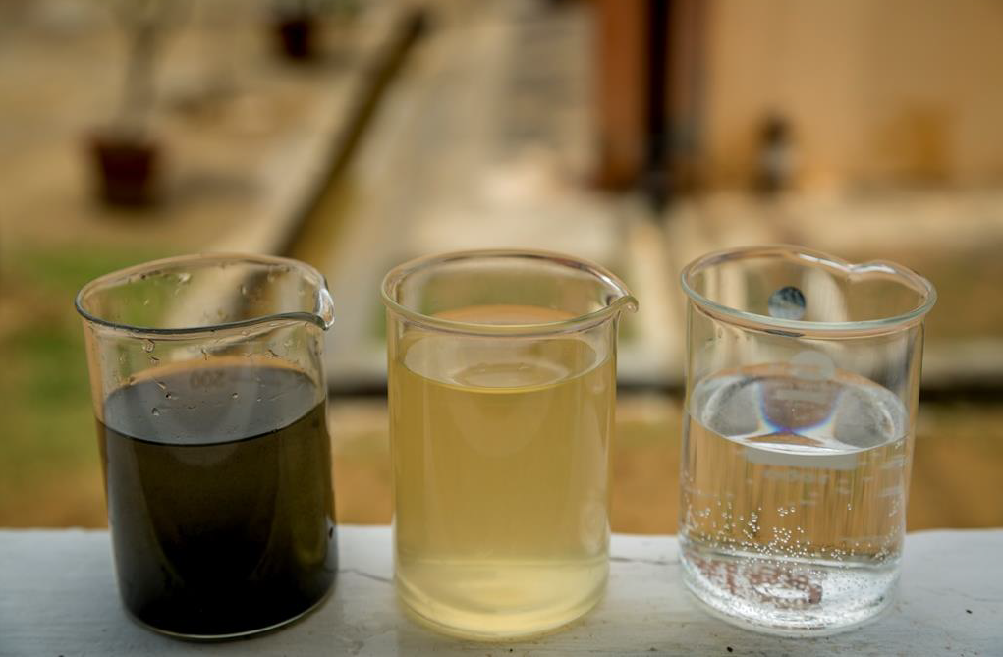
RAW SEWAGE
AFTER BIO-FILTER
AFTER MEMBRANE

Slide 18
NEW CENTRAL POLLUTION CONTROL BOARD NORMS
STANDARDS OF TREATED EFFLUENT OF SEWAGE TREATMENT PLANTS | VALUES
pH | 6.5-8.5
BOD, (mg/l) | 10
COD, (mg/l) | 50
TSS, (mg/l) | 10
NH₄ N, (mg/l) | 5
N – Total (mg/l) | 10
Fecal coli form , (MPN/100ML) | <230
PO₄-P, (mg/l) | 2
Note: •These standards will be applicable for discharge in water resources as well as for land disposal. The standards for Fecal Coli form may not be applied for use of treated sewage in industrial purposes •Achievements of Standards for existing STP’s within 05 years from date of notifications

Slide 19
OPERATING PLANT & OPEX
CAPACITY : 100 KLD
LOCATION : DELHI JAL BOARD ( DJB)
KESHOPUR STP PLANT
NEW DELHI
INPUT : RAW SEWAGE
OUTPUT : DRINKING WATER
OPEX Paisa 1.8/litre
*KLD: Kilo Litres a day

Slide 20
1 MLD WATER RECOVERY PLANT
OPEX
POWER/CONSUMABLES/ MANPOWER
SEWAGE TREATMENT : Paisa 0.6 /litre
WATER RECOVERY : Paisa 1.8 /litre

Slide 21
AWPL TREATED WATER CAN BE USED FOR
With use of our special membrane:
Drinking
Bathing
Washing
Without use of special membrane, Tertiary Treatment: (non-potable)
Flushing of toilets
Cooling towers(AC)
Ground water recharging
River rejuvenation
Irrigation/Horticulture
Industrial :
Tannery
Construction
Food processing
Sugar mills
Dairy
Textile
Commercial/Institutes/Hotel/Resort/Residential areas

Slide 22
BIOFILTER WASTE
( Once in six months)
HUMUS
Soil Porosity
Nutrients
Soil Fertility
Can Be Marketed ( To Nursery)

Slide 23
INLET & OUTLET WATER CHARACTERISTICS
PARAMETERS | UNIT | RAW SEWAGE | AFTER BIOFILTER | ATER MEMBRANE FILTRATION
pH |  | 6.0 to 7.0 | 6.5 to 8.5 | 6.5 to 8
TDS | ppm | 600-800 | 400-600 | 150-250
Turbidity | NTU | 40 -100 | < 10 | < 1
Suspended solids | ppm | Up to 700 | < 50 | < 1
COD | ppm | Up to 500 | < 100 | < 10
BOD | ppm | Up to 250 | < 30 | < 2
DO | ppm | NIL | 2 – 3.5 | 2 – 3.5
Colour |  | Dark Grey | Pale Yellow | Colourless
Odour |  | Strong | Odourless | Odourless
Survival of Aquatic organisms |  | NIL | Fish, Frogs, Tortiose can survive | Fish, Frogs, Tortiose can survive

Slide 24
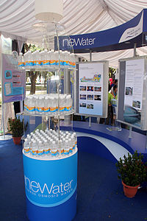
WATER RECYCLING AROUND THE WORLD
NeWater Singapore
NEWater is the brand name given to reclaimed water produced by Singapore's Public Utilities Board. More specifically, it is treated wastewater (sewage) that has been purified using dual-membrane and ultraviolet technologies, in addition to conventional water treatment processes.
neWater meets 45 % of Singapore’s drinking water

Slide 25
WATER RECYCLING AROUND THE WORLD AND SPACE
Space stations recycle their human waste and convert that into drinking water so that they don’t use the packaged water too much…
In Adelaide, Australia, the treated sewage is discharged into the Murray-Darling rivers, which are then used as drinking water sources for the cities downstream
The Orange County Water, California treat the raw sewage and use the same for ground water recharging

Slide 26
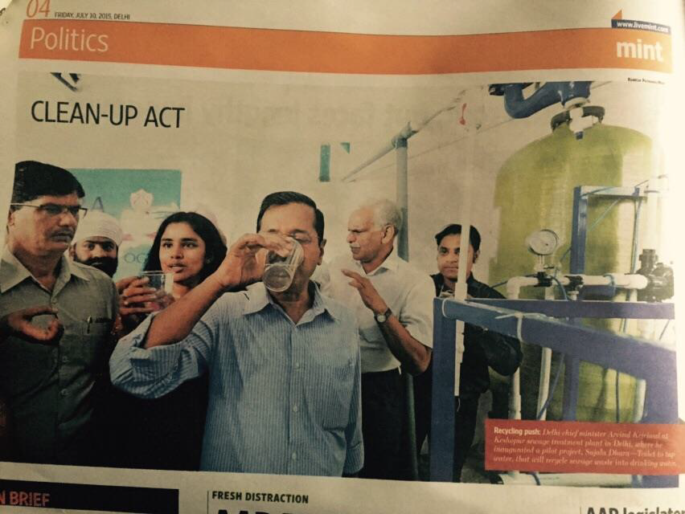
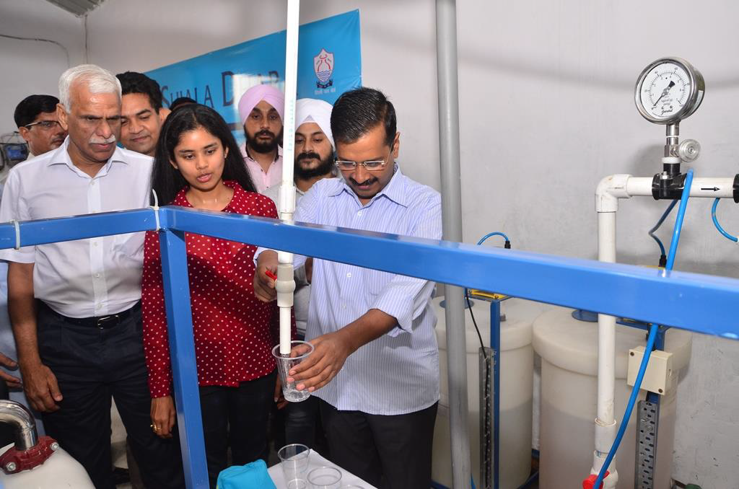
ABSOLUTE WATER KESHOPUR PLANT INAUGURATED BY DELHI C.M. MR. KEJRIWAL ON JULY 09, 2015

Slide 27
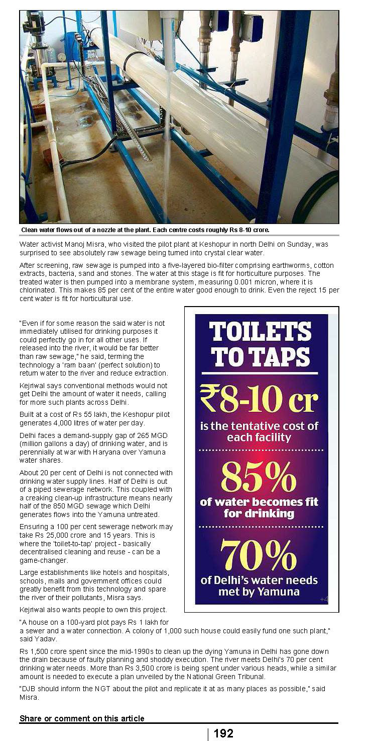
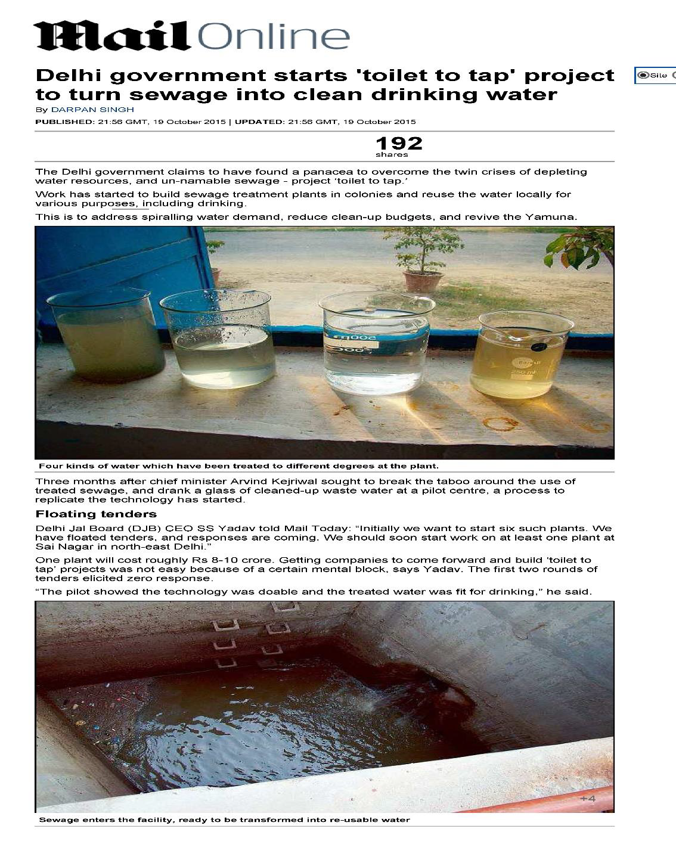
ABSOLUTE WATER :IN MEDIA

Slide 28
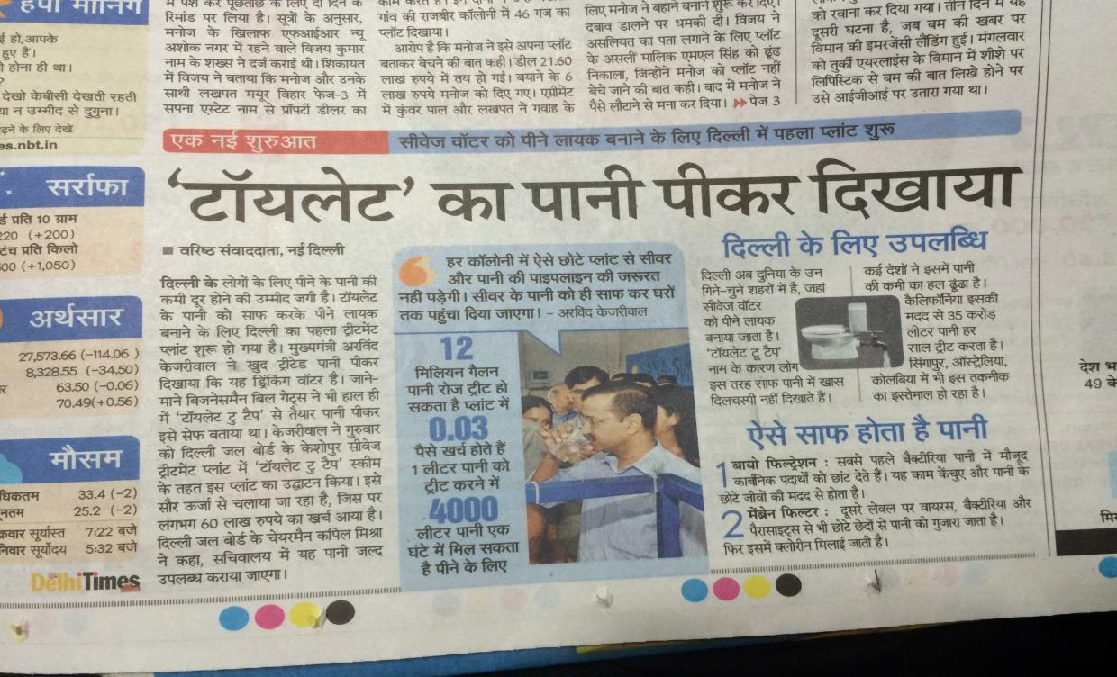
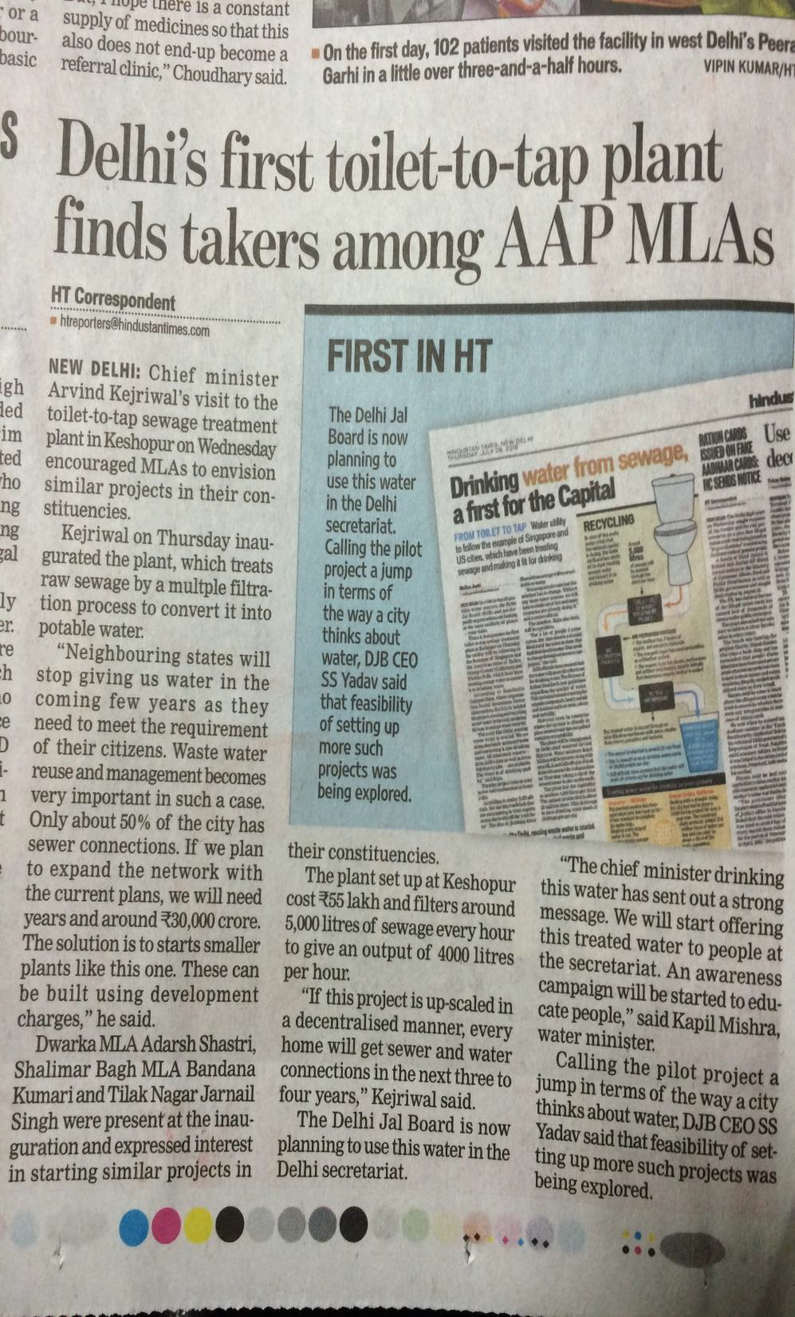
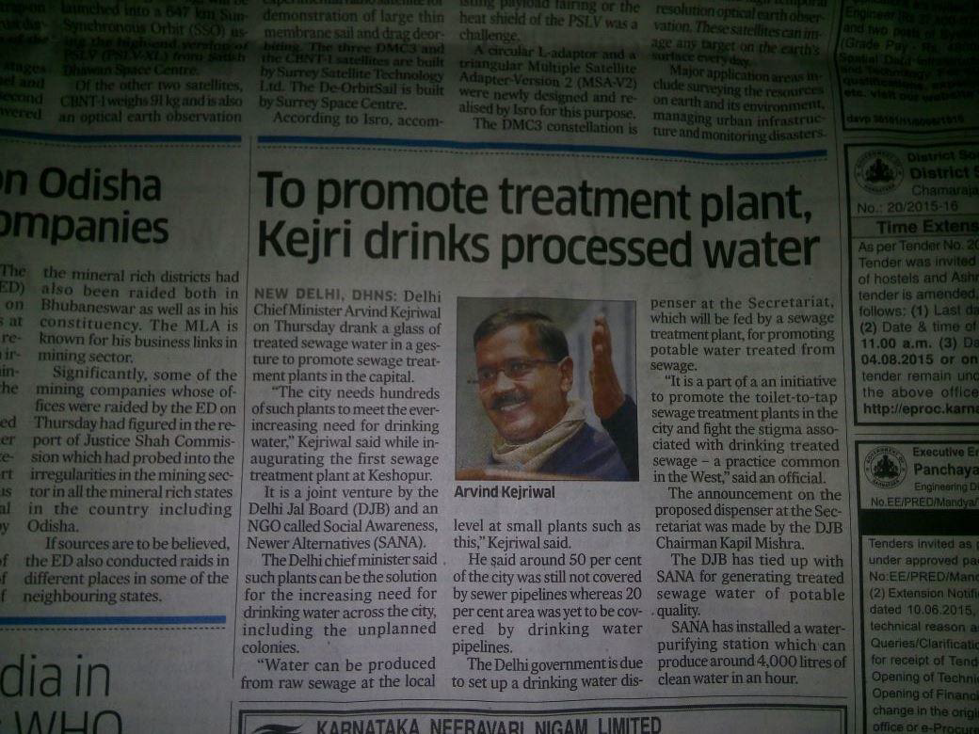
ABSOLUTE WATER :IN MEDIA

Slide 29
PLANT VISITED AND APPRECIATED BY :
•DR. A.K. AKOLKAR
MEMBER SECRETARY
CENTRAL POLLUTION CONTROL BOARD
•DR. SUNEEL DAVE
NATIONAL MISSION OF CLEAN GANGA
•DR. ABSAR AHMAD KAZMI
PROFESSOR , IIT ROORKEE
ON BEHALF OF NGT
•DR. VINOD TARE
PROFESSOR , IIT KANPUR
•SHRI MANOJ MISHRA
CONVENER
YAMUNA JIYE ABHIYAN
•TEAM FROM CENTRE FOR SCIENCE AND ENVIRONMENT
•SHRI ARVIND KEJRIWAL, CHIEF MINISTER , DELHI
•SHRI KAPIL MISHRA
CHAIRMAN DJB, WATER MINISTER, DELHI
and many more

Slide 30
ABSOLUTE WATER PRESTIGIOUS CLIENTELE
DJB
Lanxess
Ecoware
Saraswati Medical Institute, Hapur
Silver Oaks Engineering College, Ahemdabad
Surya Resort, Allahabad
ISGEC Heavy Engineering Ltd.
Guru Nanak Dev Engineering College, Ludhiana
Chilkur Balaji Temple, Hyderabad
Nuts and Spices Dairy division, Chennai
Delhi Technological University, New Delhi
And Many More..

Slide 31
AREAS OF EXPERTISE
WATER RECOVERY FROM RAW SEWAGE
ZERO LIQUID DISCHARGE
ONLINE MONITORING FOR ETP AND STP PLANT
WATER RECOVERY FROM EXISTING SEWAGE TREATMENT PLANT’S
SULPHATE REMOVAL SYSTEMS MAINLY IN SUGAR MILLS
ETP UPGRADATION
COOLING TOWER CONDENSATE RECOVERY
RO PLANTS

Slide 32
THANK YOU
ABSOLUTE WATER
M 58, III Floor, M Block Market,
Greater Kailash II, New Delhi – 110 048
Tel : +91 11 2921 6344
Email : Enquiry@absolutewater.In
www.absolutewater.In

